Slide 1
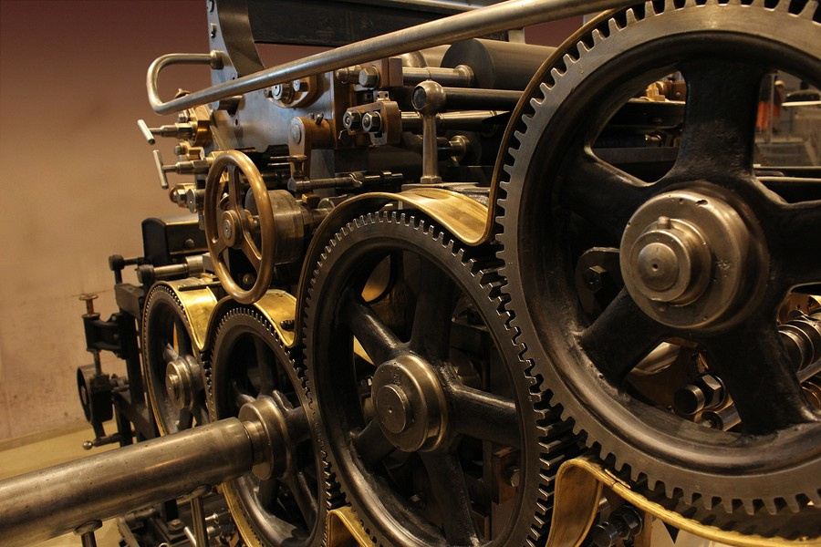
Machine Learning for Predictive Maintenance
Capstone Project
Fatta Gurung

Slide 2


Why Predictive
Maintenance ?
Save Money
Unforeseen downtime in production can cost millions of dollars of losses.
Increase Productivity
We can make our operations and monitoring teams more productive with predictive maintenance

Slide 3
Problem Statement
Preventive maintenance helps avoid unexpected failures by addressing problems in advance.
Maintenance can be costly.
Predictive maintenance is more efficient as it helps prevent problems before they happen.
We can fix machines just in time by monitoring and predicting their status.

Slide 4
Objectives
Primary objective ​
​ - Suggest machine learning solutions for predictive maintenance.​
Secondary Objectives
Create a machine learning model that can classify the nature of machine failure.

Slide 5
Approach
Failure prediction:
Logistic Regression
KNN
Random Forest
Support Vector Machine (SVM)

Slide 6
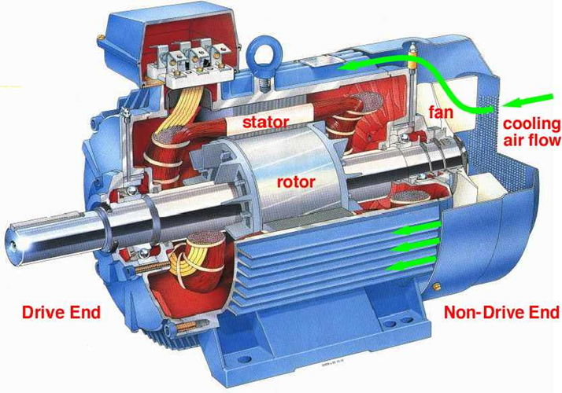
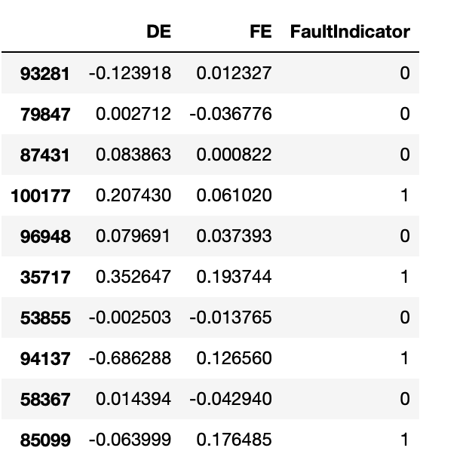
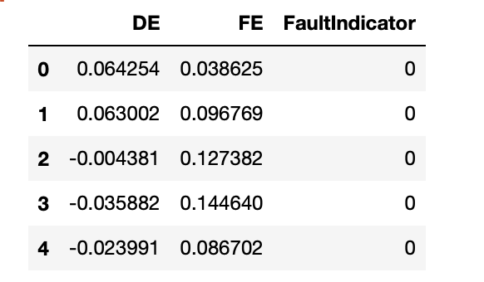
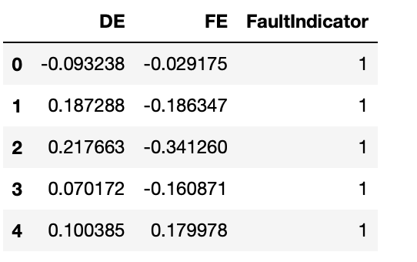
Dataset consist of two files with the fault in the bearing and fan. Data were read and combined using pandas.
Data Dictionary
DE: Drive end accelerometer data.
FE: Fan end accelerometer data.
0: Fault in Bearing
1: Fault in Fan
EDA-I
Bearing Data
Fan Data

Slide 7
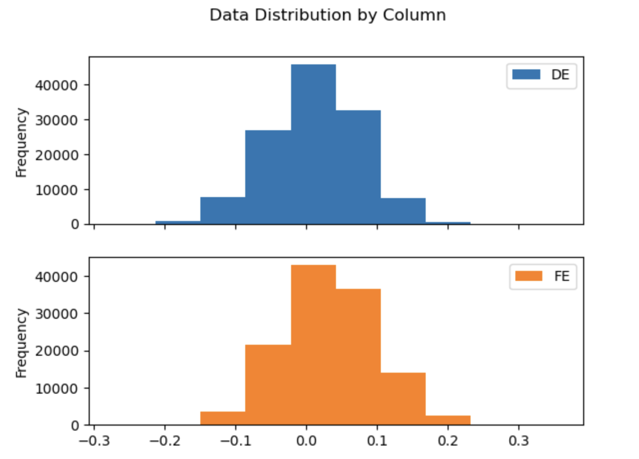
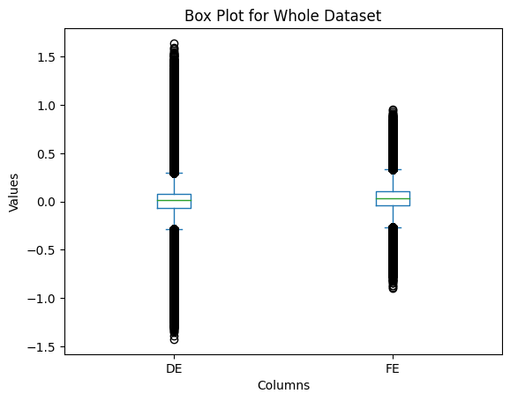
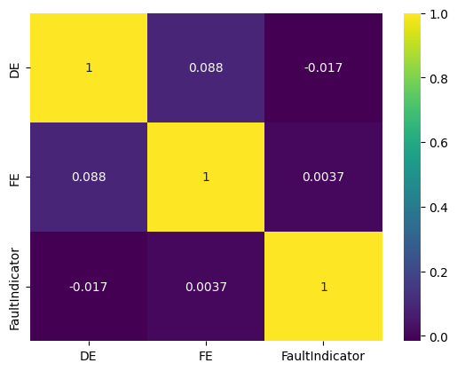
Dataset were normalized from the source.
We can see from histogram and the box plot dataset is shows the normal distribution pattern.
Correlation between the columns is not high as expected this could be due to the sample bias.
EDA-II
Notes:
Box plot shows all the data in the outliers region. That is probably due to the fact that all the data that doesn't fall in inter quartile range causes issue in the machine.
Sample bias occurs when we unknowingly sample certain group from the population with higher probability of the occurring.

Slide 8
ML Modelling Steps
Dividing Data into train test dataset
Creating an instance of the model
Model fitting in training dataset
Prediction in testing dataset
Comparing model metrics
Notes:
- Model instantiation --- ML object creation

Slide 9
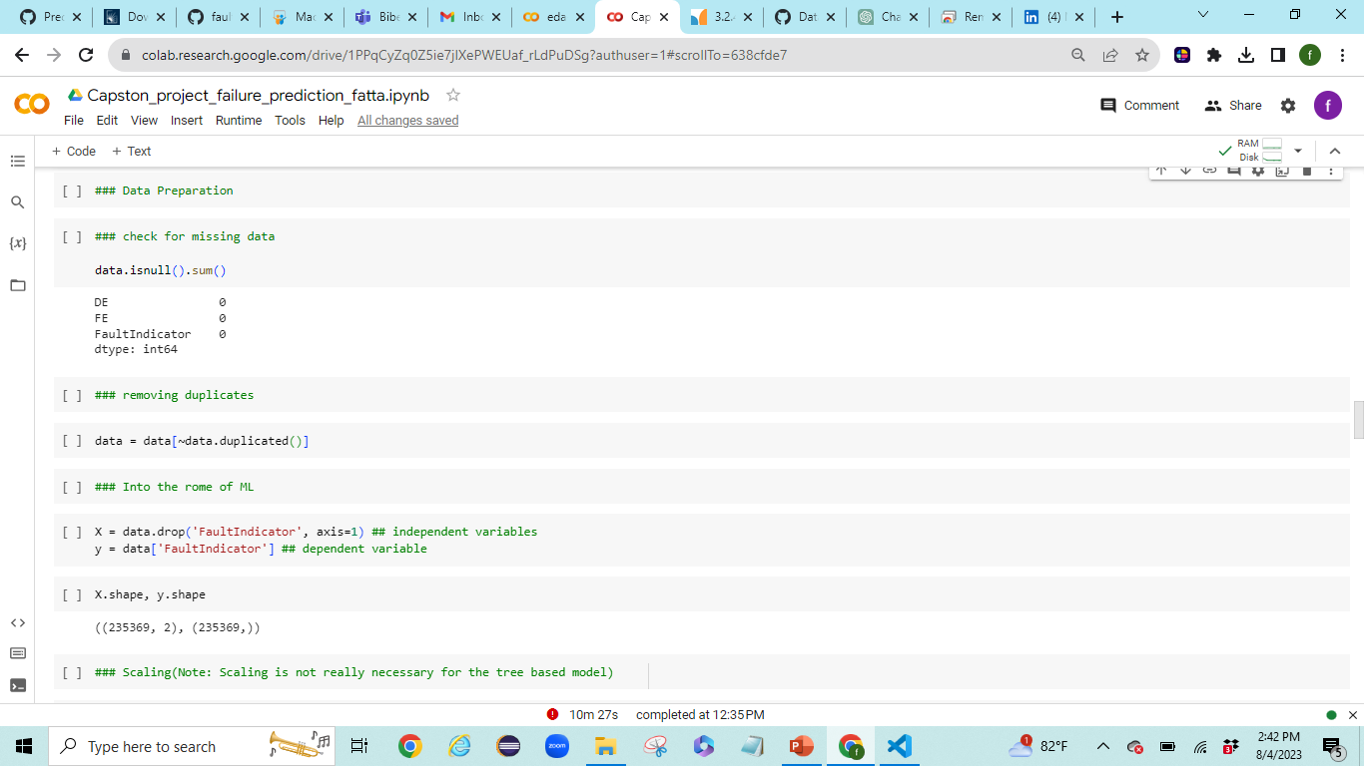
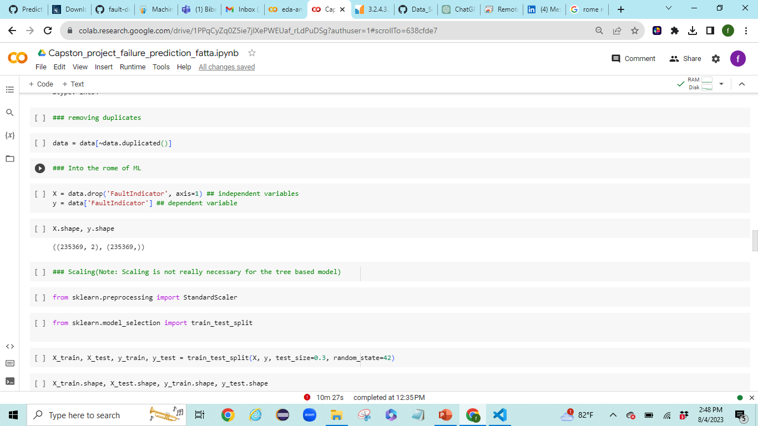
Importing Necessary Library
import numpy as np
import pandas as pd
import matplotlib.pyplot as plt
import seaborn as sns
from sklearn.linear_model import LogisticRegression
from sklearn.ensemble import RandomForestClassifier
from sklearn.neighbors import KNeighborsClassifier
from sklearn.metrics import precision_score, recall_score, \
f1_score, accuracy_score, confusion_matrix, ConfusionMatrixDisplay
ML Steps -I
Checking Missing Data
There were no missing data in the dataset. On observing dataset was balanced.
Separating the dependent and independent variables.
Notes:
Imbalanced dataset is When the percentage of the dependent variables are not equal

Slide 10
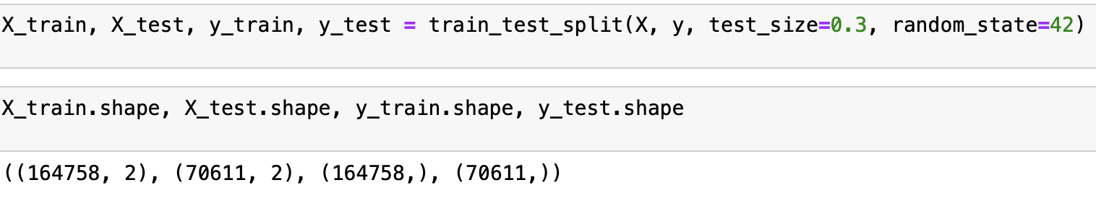
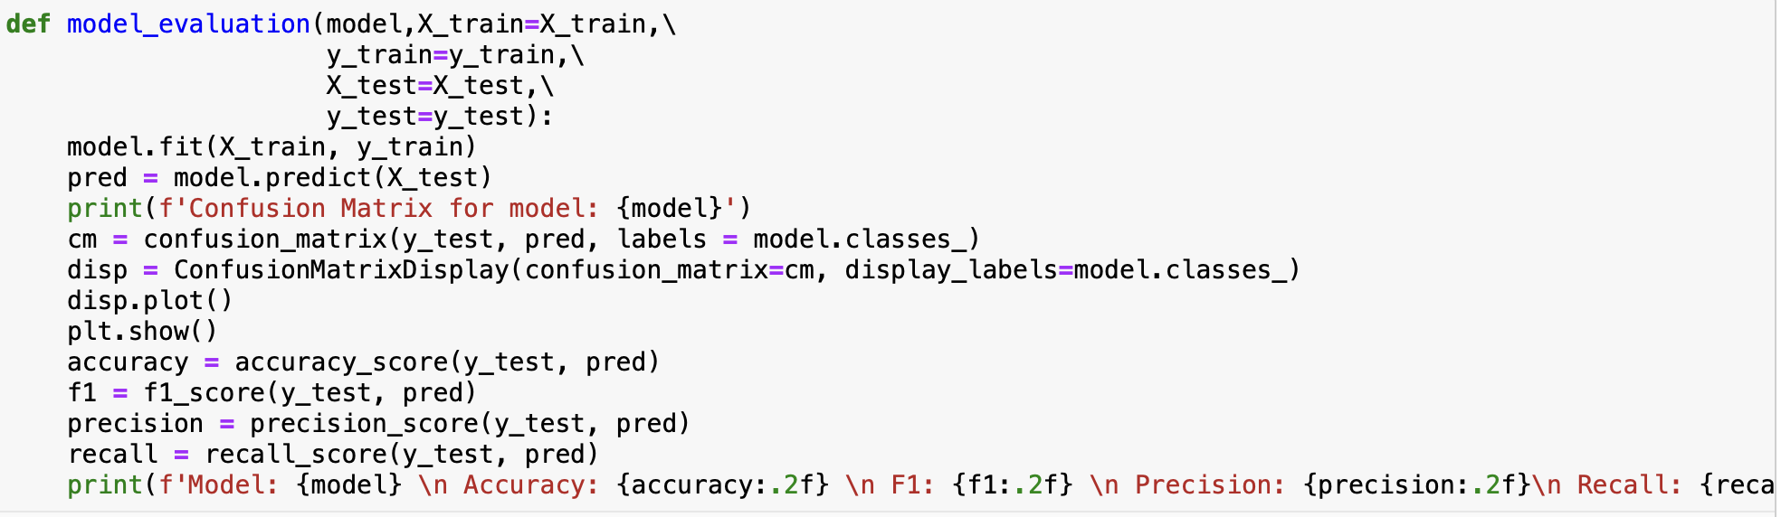
Data Split
Splitting data into train and test bucket helps to build model using training set and test model on the testing set. This is to create environment as realistic as the real world where model will be used in unseen data.
Creating ML Function
Creating ML model within the function helps to reuse the same code for the various model.
ML Steps -II
Notes:
Imbalanced dataset is When the percentage of the dependent variables are not equal

Slide 11
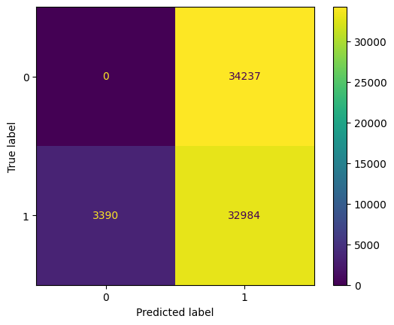
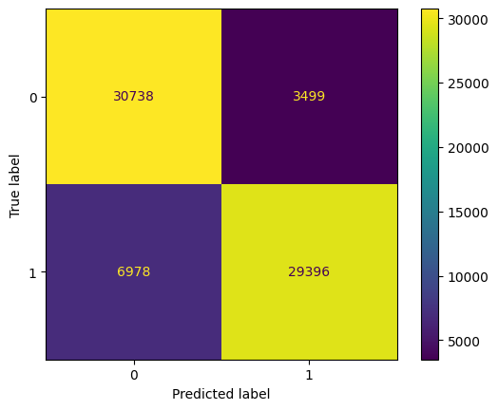
Logistic Regression
Accuracy: 0.47
F1: 0.64
Precision: 0.49
Recall: 0.91
3390 was 1 (actual value) , real but predicted 0 (FN)
34237 was 0 (actual value) , real but predicted 1 (FP)
Model Result -I
Random Forest
Accuracy: 0.85
F1: 0.85
Precision: 0.89
Recall: 0.81
6978 was 1 (actual value) , real but predicted 0 (FN)​
3499 was 0 (actual value) , real but predicted 1 (FP)​
Notes:
Imbalanced dataset is When the percentage of the dependent variables are not equal
False positive happens when model predicts positive which is false similary False negative happens when model predicts negative which is false.
Accuracy is the ratio of correct predictions to the total number of predictions. Often it can be misleading
Recall calculates the ratio of predicted positives to the total number of positive labels.
Precision is the ratio of the correct positive predictions to the total number of positive predictions
F1 score depends on both the Recall and Precision, it is the harmonic mean of both the values.

Slide 12
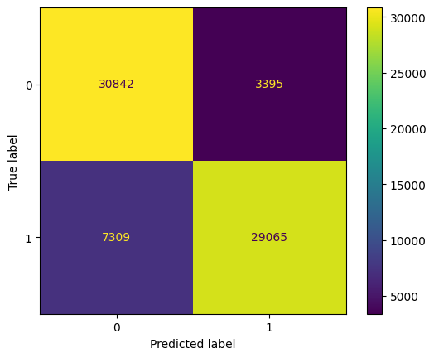
KNN
Accuracy: 0.85
F1: 0.84
Precision: 0.90
Recall: 0.80
7309 was 1 (actual value) , real but predicted 0 (FN)
3395 was 0 (actual value) , real but predicted 1 (FP)
Model Result -II
Summary
Out of the all the model Random Forest has the highest f1 score.
Notes:
Imbalanced dataset is When the percentage of the dependent variables are not equal
False positive happens when model predicts positive which is false similary False negative happens when model predicts negative which is false.
Accuracy is the ratio of correct predictions to the total number of predictions. Often it can be misleading
Recall calculates the ratio of predicted positives to the total number of positive labels.
Precision is the ratio of the correct positive predictions to the total number of positive predictions
F1 score depends on both the Recall and Precision, it is the harmonic mean of both the values.

Slide 13
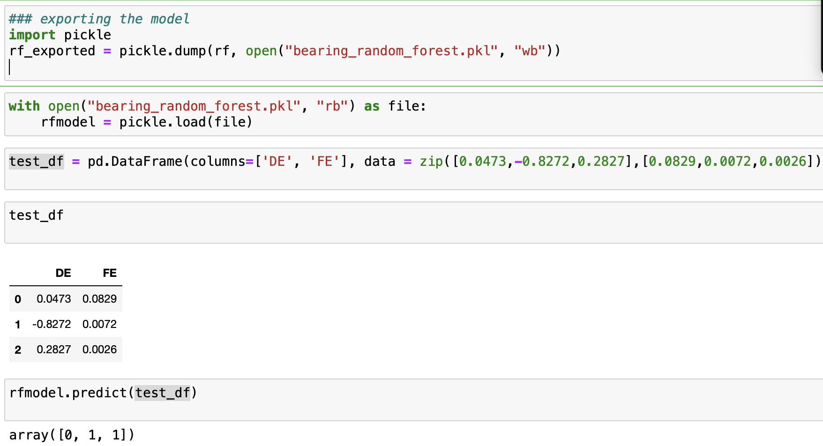
Deployment
Deployment of ML model is the last step where model is deployed to be used in the real data.
Model deployment is usually done as restful API integration or standalone.
For this use case we used pickle to save the model and we read the model and test the model in dummy data.
Model Deployment
Exporting Model to be used in real world. Here we are exporting rf model
Reading the exported model
Creating New Dummy Data
Predicting using the model read through pickle file.
Notes:
Imbalanced dataset is When the percentage of the dependent variables are not equal
False positive happens when model predicts positive which is false similary False negative happens when model predicts negative which is false.
Accuracy is the ratio of correct predictions to the total number of predictions. Often it can be misleading
Recall calculates the ratio of predicted positives to the total number of positive labels.
Precision is the ratio of the correct positive predictions to the total number of positive predictions
F1 score depends on both the Recall and Precision, it is the harmonic mean of both the values.

Slide 14
Failure prediction: Out of all Classifier random forest has 85% accuracy and highest F1 score.
F1 Score is the harmonic mean of the precision and recall.
Conclusion

Slide 15
EXTRAS

Slide 16
TP, TN, TP, FN
3390 was 1 (actual value) , real but predicted 0
(FN)
34237 was 0 (actual value) , real but predicted 1
(FP)
Model: LogisticRegression()
Accuracy: 0.47
F1: 0.64
Precision: 0.49
Recall: 0.91

Slide 17
from sklearn.ensemble import RandomForestClassifier
rf = RandomForestClassifier()
model_evaluation(rf)
Model: RandomForestClassifier()
Accuracy: 0.85
F1: 0.85
Precision: 0.89
Recall: 0.81

Slide 18
#use KNeighbors
from sklearn.neighbors import KNeighborsClassifier
knn = KNeighborsClassifier()
model_evaluation(knn)
Model: KNeighborsClassifier()
Accuracy: 0.85
F1: 0.84
Precision: 0.90
Recall: 0.80

Slide 19
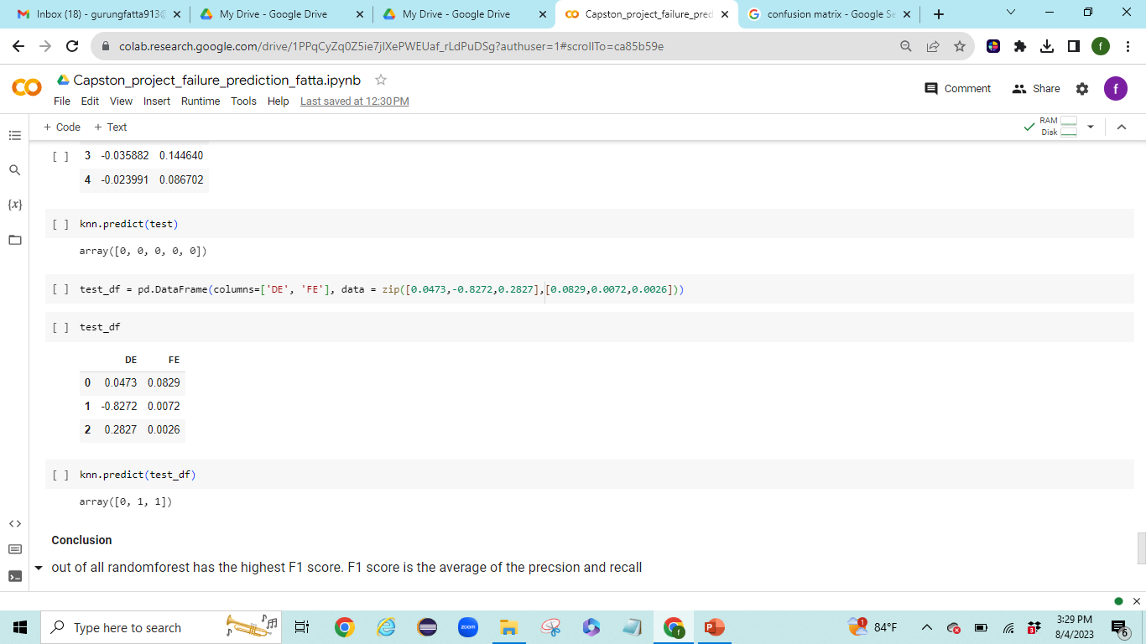
0= Fault in Bearing
1= Fault in fan

